Slide 1
IT 694
Computer Networks Fundamentals Week 2-Lecture 1

Slide 2
What is a computer network?
A set of network elements connected together, that implement a set of
protocols for the purpose of sharing resources at the end hosts
•
Three important components:
•
Core infrastructure:
• A set of network elements connected together
Protocols:
• Needed to use the network
•
•

Slide 3
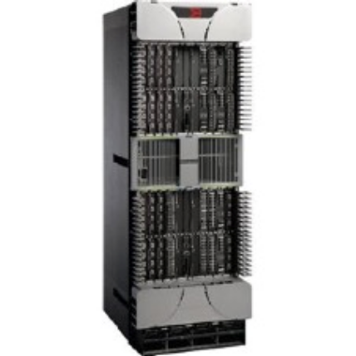

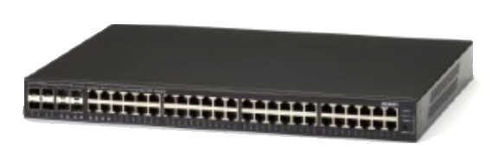
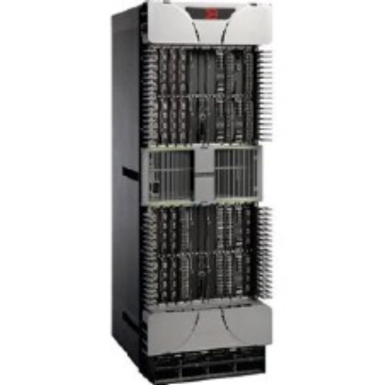

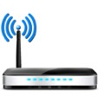
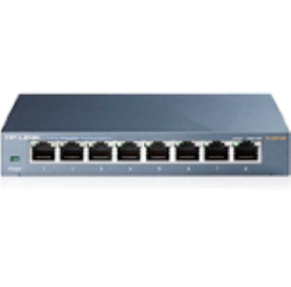





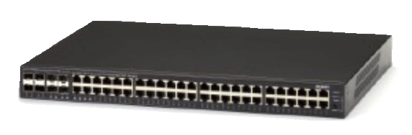
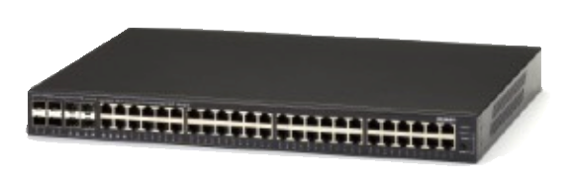
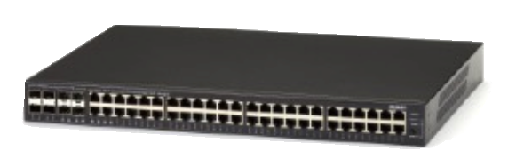


What is a computer network?
A set of network elements connected together, that implement a set of
protocols for the purpose of sharing resources at the end hosts

Slide 4
What’s a protocol?
Human protocols:
“what’s the time?”
“I have a question”
introductions
Network protocols:
computers (devices) rather than humans
all communication activity in Internet governed by protocols
Rules for:
… specific messages sent
… specific actions taken when message received, or other events
Protocols define the format, order of messages sent and received among network entities, and actions taken on message transmission, receipt

Slide 5



What’s a protocol?
A human protocol and a computer network protocol:
Hi
TCP connection
request
Hi
TCP connection
response
Got the
time?
GET http://gaia.cs.umass.edu/kurose_ross
2:00
<file>
time
Notes:
Explain important points
distributed entities, exchanging messages (governed by protocols)
Time going down
go over definition of protocol (showing format, order of messages sent and received, and actions taken)
We’ll see these kinds of diagrams a lot

Slide 6
What do computer networks do?
A computer network delivers data between the end points/hosts
•
One and only one task: Delivering the data
•
This delivery is done by:
•
•
Chopping the data into packets
Sending individual packets across the network
• Reconstructing the data at the end points
Evolution of Technology, Infrastructure, protocols, and purpose

Slide 7
















A closer look at network structure:
network edge:
hosts: clients and servers
servers often in data centers
mobile network
global ISP
access networks, physical media: wired, wireless communication links
home
network
regional ISP
network core:
interconnected routers
network of networks
institutional
network

Slide 8
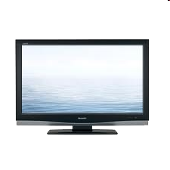


Access networks: cable-based access
cable headend
…
cable
modem
splitter
CMTS
cable modem
termination system
data, TV transmitted at different
frequencies over shared cable
distribution network
ISP
HFC: hybrid fiber coax
asymmetric: up to 40 Mbps – 1.2 Gbps downstream transmission rate, 30-100 Mbps upstream transmission rate
network of cable, fiber attaches homes to ISP router
homes share access network to cable headend

Slide 9
Access networks: digital subscriber line (DSL)
central office
telephone
network
DSL
modem
splitter
DSLAM
voice, data transmitted
at different frequencies over
dedicated line to central office
ISP
DSL access
multiplexer
use existing telephone line to central office DSLAM
data over DSL phone line goes to Internet
voice over DSL phone line goes to telephone net
24-52 Mbps dedicated downstream transmission rate
3.5-16 Mbps dedicated upstream transmission rate

Slide 10
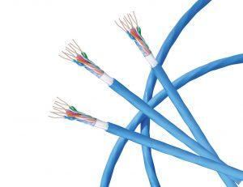
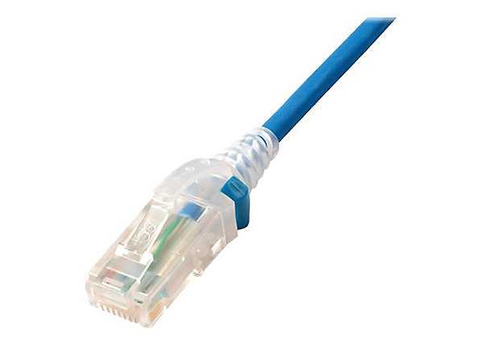
Links: physical media
bit: propagates between transmitter/receiver pairs
physical link: what lies between transmitter & receiver
guided media:
signals propagate in solid media: copper, fiber, coax
unguided media:
signals propagate freely, e.g., radio
Twisted pair (TP)
two insulated copper wires
Category 5: 100 Mbps, 1 Gbps Ethernet
Category 6: 10Gbps Ethernet

Slide 11
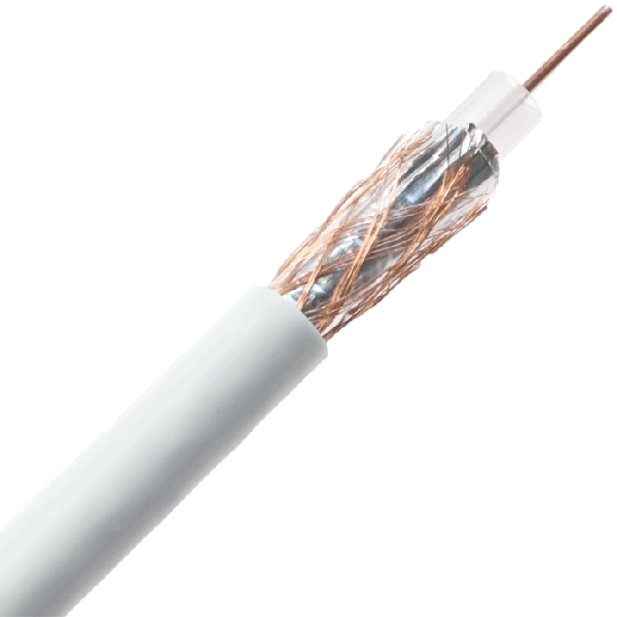
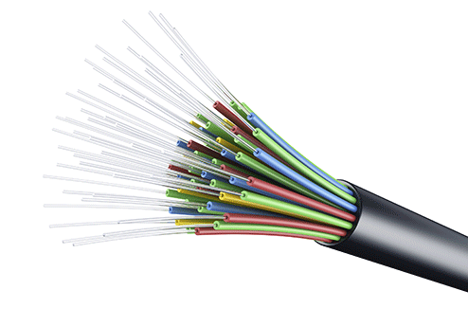
Links: physical media
Coaxial cable:
two concentric copper conductors
bidirectional
broadband:
multiple frequency channels on cable
100’s Mbps per channel
Fiber optic cable:
glass fiber carrying light pulses, each pulse a bit
high-speed operation:
high-speed point-to-point transmission (10’s-100’s Gbps)
low error rate:
repeaters spaced far apart
immune to electromagnetic noise

Slide 12









The network core
mesh of interconnected routers
packet-switching: hosts break application-layer messages into packets
forward packets from one router to the next, across links on path from source to destination
each packet transmitted at full link capacity

Slide 13
Many mechanisms: What do we mean by …
Locating a destination? →Naming, Addressing
Finding path to the destination → Routing
Sending data to the destination → Forwarding
Failures, reliability,etc..→ Distributed routing and congestion control

Slide 14
How GOOD is a NETWORK?

Slide 15
What do we look at before commuting to places?
Which are the possible routes to take from DAIICT to home?
Which one is the best?
How long does it take to reach my home from DAIICT?
What is the capacity of a road(s) between DAIICT and home?

Slide 16
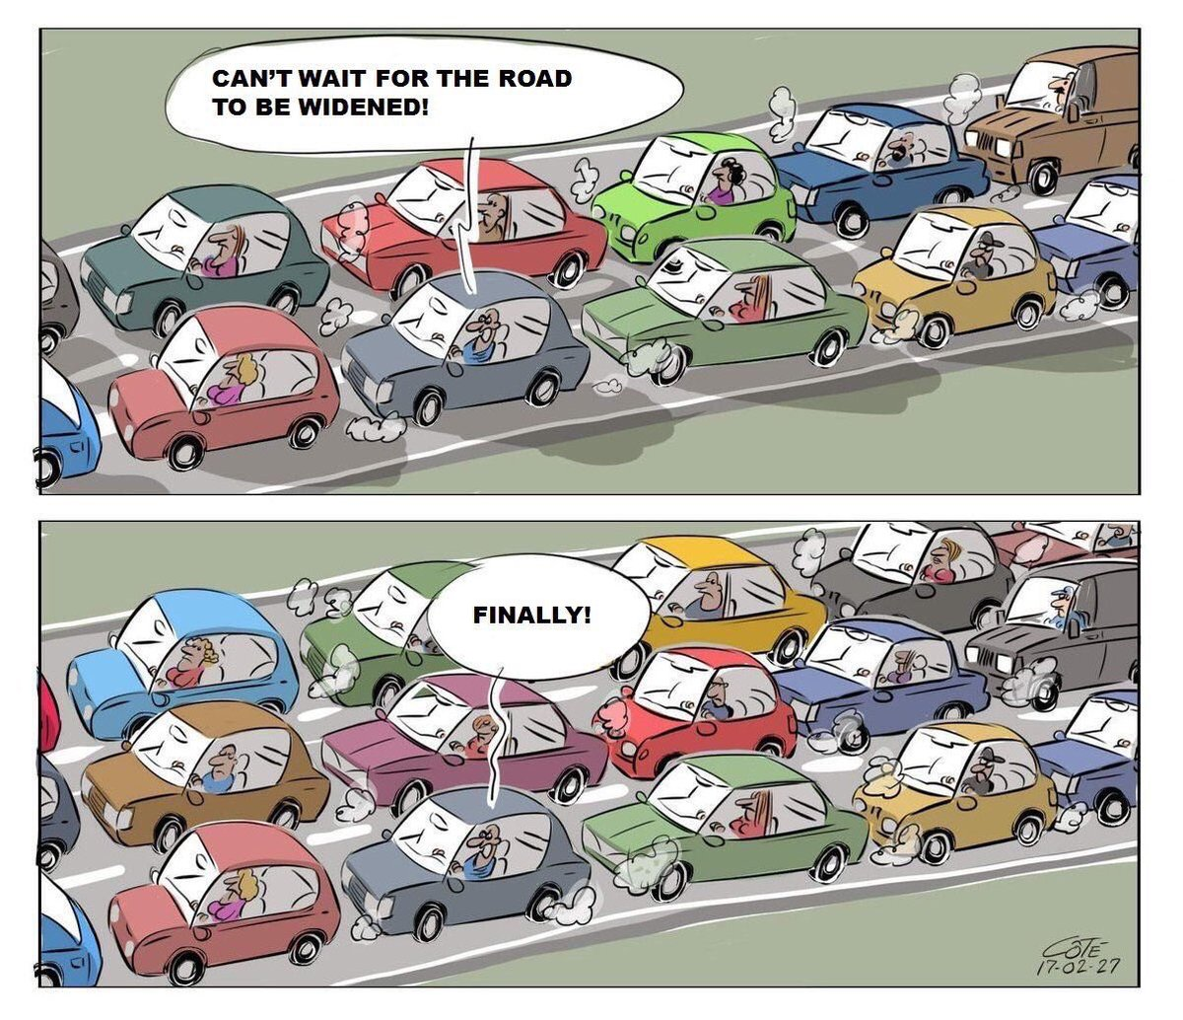
Capacity
How wide is the road?
How fat is the tunnel?
How many cars can fit at a time?
One, two, three…?

Slide 17

Performance metrics in computer networks!
Capacity is Bandwidth: Number of bits sent per unit time (bits per second, or bps)
• Depends on
• Hardware
• Network traffic conditions
Bandwidth
Time taken is Propagation delay: Time for one bit to move through the link (seconds)
• Depends on
•
•
Hardware
Network traffic conditions
Propagation
Delay
• How large is the unit?

Slide 18
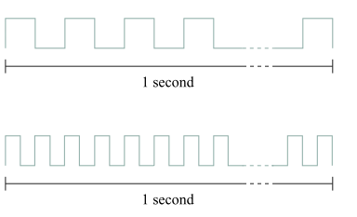
Bandwidth
Each bit is a pulse of some width.
For example, each bit on a
1-Mbps link is 1 µs wide
2-Mbps link is 0.5 µs wide,
The narrower each bit can become, the higher the bandwidth.
This means more bits can get inside the tunnel
So MORE DATA CAN FLOW WITHIN A TIME

Slide 19
Bandwidth-delay product (BDP)
Number of bits “in flight” at any point of time (bits)
• Bits sent, but not received
Bandwidth
Bandwidth x delay
Propagation
Delay
•
Same city over a slow link
•
Bandwidth: ~100Mbps
• propagation delay: ~0.1ms
• BDP = 10,000 bits (1.25KBytes)
Between cities over fast link:
• Bandwidth: ~10Gbps ,
propagation delay: ~10ms
• BDP = 100,000,000 bits (12.5MBytes)

Slide 20

Who is the father of the Internet?
Who is the father of the World Wide Web?
Vincent Cerf
Tim Berners Lee

Slide 21
Match
PC
End
Intermediary
Printer
End
Intermediary
Firewall
End
Intermediary
Smart Device
End
Intermediary
Router
End
Intermediary
Switch
End
Intermediary

Slide 22
A person X recently got a job with a computer support services company in his hometown Gandhinagar. A customer has asked for someone to come connect their home network to the Internet. They only have a cable modem. Which of the following devices would X most likely take with him to complete the task?
wireless router
LAN switch
desktop computer
firewall appliance
wireless router

Slide 23
Match
PC
End
Intermediary
Printer
End
Intermediary
Firewall
End
Intermediary
Smart Device
End
Intermediary
Router
End
Intermediary
Switch
End
Intermediary

Slide 24
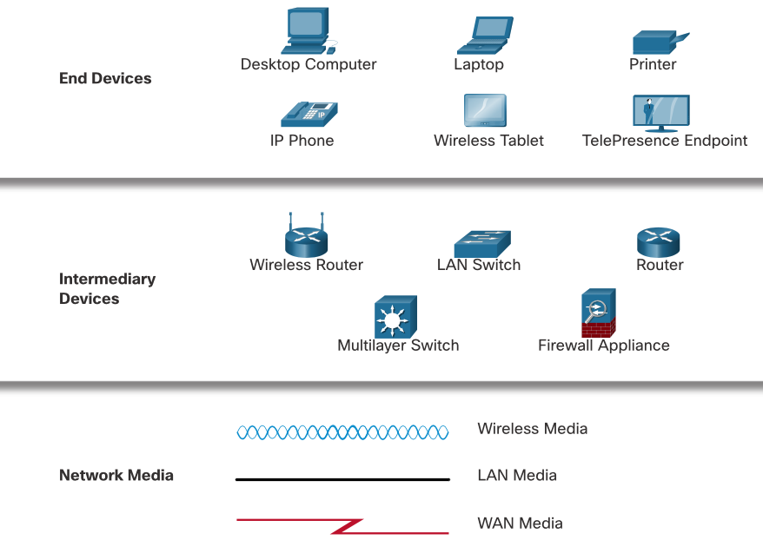
Source: Cisco Networking Academy

